Slide 1
DESIGN PHASE
BY
GROUP B

Slide 2
GROUP MEMBERS
1) ABDUL RAHMAN JASIM - VU-BSF-2407-2235-DAY
2) NABATANZI NORAH NURU - VU-BSF-2407-1638-DAY
3) SSERUYANGE MARVIN - VU-BSF-2470-2070-DAY
4) SSEMAKULA MAHAD - VU-BSF-2407-2646-DAY
5) MALIAMUNGU WILSON MARK- VU-BSF-2407-1496-DAY
6) STEPHEN MURUYE - VU-BIT-2301-0225-DAY

Slide 3
System Design
System design is about the creation of the architecture of the system based on the requirement gathered in the previous phase, which is Analysis. It describes how the components of the system will interact among themselves and the users. For example below are the designs;
Architectural Design
Database Design
Security Design
Module Design

Slide 4
1. Architectural Design ;
User data will be stored in a relational database, along with settings, posts, and associations between data entities or users regarding their privacy settings.
2. Database Design ;
A high-level design for the overall architecture of the system is drawn: front-end user interface, a back-end server, and the database where user data will be stored along with privacy settings.
3. Security Design;
Since privacy is the focal point, strong security mechanisms will be integrated: encryption for storing passwords and user data securely, multi-factor authentication for enhanced user account security in use.

Slide 5
4. Module Design;
User Management Module: The module takes care of user account creation, login, and security settings.
Privacy Settings Module: Provides the facility to control by whom the posts, stories, or other stuff is shared.
Notifications Module: Governs notifications related to privacy changes or any security alerts to the users.

Slide 6
User Interfaces (UI) and System Interfaces
User Interface Design: It focuses on how a user will interact with the Instagram privacy management system. This includes layout pages for settings and features.
A settings page will allow users, for example, to toggle between options such as "Only Me," "Friends," and "Public" for each privacy category.
Simple, intuitive, and responsive design targeted for smartphones, tablets, and desktops.

Slide 7
System Interface Design: It describes how different system components will interface with each other. Example:
Database Interface: The system should interface with the backend database for the purpose of storing and retrieving user preferences.
Third-Party APIs: If there are external systems or services involved, such as authentication providers, the system must be able to interface with those securely.

Slide 8
Data Flow Diagrams (DFDs)
Level 0 DFD :
A high-level diagram showing the system as a single process with external entities: users, external databases, etc.
Process: Instagram Privacy Management System
External Entities: Users, Instagram servers
Data Flow: Data such as privacy settings, user profiles, and security preferences flow between the system and the external entities.

Slide 9
EXAMPLE OF 0-LEVEL DFD
INSTAGRAM
PRIVACY
MANAGEMENT
SYSTEM
USER
INSTAGRAM
SERVER
PRIVACY SETTING
SECURITY PREFRENCES
CONTENT
USER PROFILE

Slide 10
Level 1 DFD - Decomposed Diagram:
This is the system broken down into major processes; for example:
Process 1: User Authentication (login, register, etc.)
Process 2: Privacy Settings Management-edit visibility preferences
Process 3: Security Settings Management-turn on/off two-factor authentication

Slide 11
EAMPLE OF 1-LEVEL DFD
User authentication
visibility preferences
Security Settings Management-turn
Log in
Privacy Settings Management-edit
authentication

Slide 12
Data Dictionary
A data dictionary defines the meaning, structure, and format of the data in the system. Example:
Users Table:
user_id: Integer, Unique ID for each user.
username: String, User's Instagram handle.
email: String, User's email address.
password: String, Encrypted user password.

Slide 13
Privacy Settings Table:
user_id: Integer, References Users.user_id.
post_visibility: Enum (Public, Friends, Only Me).
story_visibility: Enum (Public, Friends, Only Me).

Slide 14
Entity-Relationship (ER) Diagram
ER diagram depicts the visual relation of various entities that are part of the database. This includes:
Users: A one-to-many relationship with the Privacy Settings (one user having many privacy settings)
Users: One to many with Security Settings (one user with many security settings).
This ER diagram will further clarify which keys, primary or foreign, should be used and how these two or more entities may have one-to-many or many-to-many relationships with each other.

Slide 15
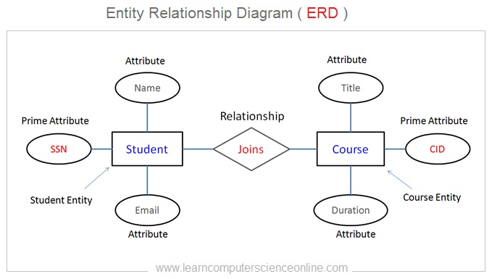

Slide 16
conclusion
Consequently, the Instagram Privacy Management System is designed to ensure that all users will have full control over their privacy and security settings. The design of the system ensures ease of use with security at a high level, supported by data encryption and multi-factor authentication. This is to instill trust in the users while assuring them of a secured platform to manage their personal privacy on Instagram.
Thank you

